Slide 1
Learning Day : Design Patterns Factory Patterns
25/09/14

Slide 2
Agenda
What Are Factories
The Simple Factory (Not a Pattern)
The Factory Method Pattern
The Abstract Factory Pattern
Comparison of the Factory Patterns

Slide 3
01. What Are Factories?
Factories provide a way of decoupling object instantiation code away from client classes, and encapsulate that code into its own class.
Why Would You Use a Factory?
If you need to create one of several possible classes that share a common interface.
Allows several classes to be clients of your factory, creating a one to many relationship. This centralises the object creation code.
Makes it possible to choose which object to instantiate at runtime.

Slide 4
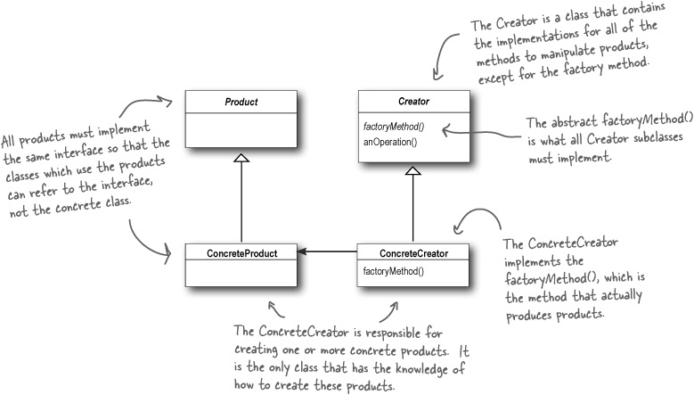
02. What Are Factories?
Head First : Design Patterns

Slide 5
02. What Are Factories?
Factories are classes that have a method of the form,
InterfaceType *<name> createObject(arg)
The arg is used to define which particular object we would like created.
Factories rely heavily on polymorphism.

Slide 6
03. What Are Factories?
Typical Code to Instantiate Related Concrete Classes…
Duck* duck;
If(picnic)
{
duck = new MallardDuck();
}
else if(hunting)
{
duck = new DecoyDuck();
}
else if(bathTub)
{
duck = new RubberDuck();
}
DuckShop Class
CountrySide Class
Duck* duck;
If(picnic)
{
duck = new MallardDuck();
}
else if(hunting)
{
duck = new DecoyDuck();
}
……….
….
Duck* duck;
If(picnic)
{
duck = new MallardDuck();
}
else if(hunting)
{
duck = new DecoyDuck();
}
……….
….
Both these classes are using the same code to generate an instance of a duck.

Slide 7
04. What Are Factories?
CountrySide Class
DuckShop Class
Duck* duck;
DuckFactory df =
new DuckFactory();
Duck = df.createDuck(“Picnic”);
Creating a Factory Class…
Duck* duck;
Duck* DuckFactory::createDuck
(std::string arg_duckType)
{
If(arg_ducktype == “picnic”)
{
duck = new MallardDuck();
}
else if(arg_ducktype == “ hunting”)
{
duck = new DecoyDuck();
}
else if(arg_ducktype == “ bathTub”)
{
duck = new RubberDuck();
}
return duck;
Duck* duck;
DuckFactory df =
new DuckFactory();
Duck = df.createDuck(“hunting”);
DuckFactory Class
Duck* duck;
If(picnic)
{
duck = new MallardDuck();
}
else if(hunting)
{
duck = new DecoyDuck()
Take out the code to instantiate an object and encapsulate it into a single factory class, which has a create method.

Slide 8
05. What Are Factories?
What’s the Advantage of Putting this Code into a Factory Class…
Supports multiple clients.
By encapsulating this code in a single class will mean there is only one place to make modifications in the future.
We can sub class our Factory Class to make other factories that will inherit all the behaviour of the parent class, with the benefit of being able to modified that behaviour. This is an important feature of Factory Patterns.

Slide 9
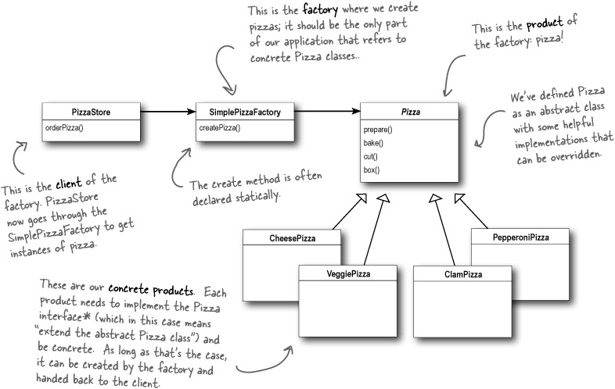
The Simple Factory (Not a Pattern)
Head First : Design Patterns

Slide 10
The Simple Factory (Not a Pattern)
The simple factory is not considered to be a pattern, rather it is thought to be more of an programming idiom.
The main point separating the Simple Factory from the Factory Method Pattern (discussing that next!) is that the Simple Factory is a concrete class, and is not intended to be subclassed.
In the Factory Method Pattern, a factory interface is declared with a createMethod() declaration. A factory subclass implements the interface, and the decision making is implemented in the sub classes createMethod().
The Factory Method Pattern is therefore a framework, and allows different subclasses to create different groups of objects. So while the Simple Factory appears very similar to the Factory Method Pattern, it does not have this flexibility. Transitioning from the Simple Factory to the Factory Method should be relatively easy.

Slide 11
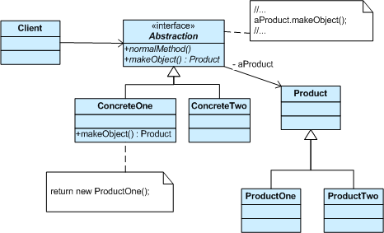
The Factory Method Pattern
The Factory Method Pattern defines an interface for creating an object, but lets subclasses decide which class to instantiate. Factory method lets a class defer instantiation to subclasses.

Slide 12
The Factory Method Pattern
Demo

Slide 13
The Abstract Factory Pattern
Used if you need to create a specific grouping of products.
ie, create a pizza using a specific set of ingredients for a region.
Ensures that clients create products that belong together.
ie, an ingredient factory will produce a specific set of ingredient for that region.
This allows us to implement a variety of factories that produce products meant for different contexts, such as different regions, different operating systems, or different GUI.
Since the instantiation code is decoupled from the client class through the use of interfaces, we can substitute different factories to get different behaviours.

Slide 14
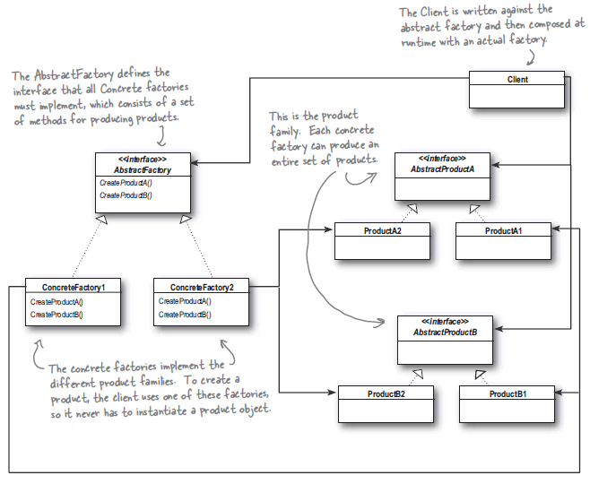
The Abstract Factory Pattern
Head First : Design Patterns

Slide 15
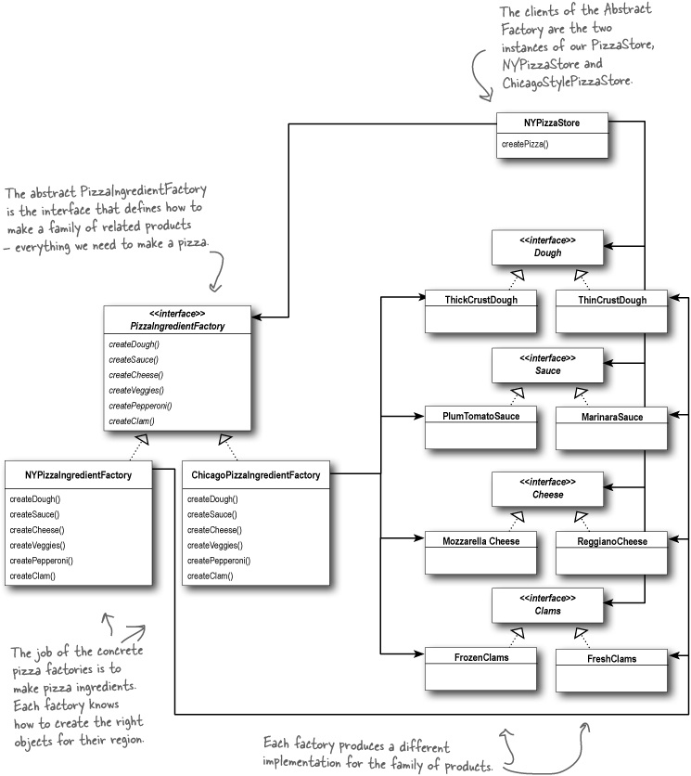
The Abstract Factory Pattern
Head First : Design Patterns

Slide 16
The Abstract Factory Pattern
Pizza* ChicagoPizzaStore::createPizza(std::string arg_pizzaType)
{
if (arg_pizzaType == "cheese")
{
this->pizza = new ChicagoStyleCheesePizza(new ChicagoPizzaIngredientFactory());
}
else if (arg_pizzaType == "pepperoni")
...
return pizza;
}
virtual void setupIngredients(PizzaIngredientFactory *arg_ingredientFactory)
{
this->dough = arg_ingredientFactory->createDough();
this->sauce = arg_ingredientFactory->createSauce();
this->cheese = arg_ingredientFactory->createCheese();
this->veggies = arg_ingredientFactory->createVeggies();
}

Slide 17
References
Download Visual Studio 2013 Desktop here
Clone this Git repo to get the source code shown here…
$ git clone https://davenolan1@code.google.com/p/design-patterns-for-cpp/
Freeman, E. and Freeman, E. (2004) Head First Design Patterns. O’Reilly Media.
(Several copies available in Aspire)

